Slide 1

What is a hydro power plant?
Notes:
So, let’s start from the fundamental definition of a hydro power plant

Slide 2
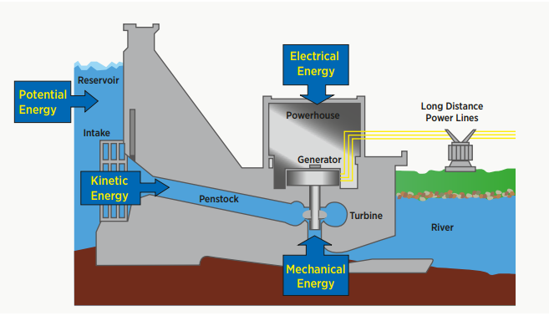
Hydropower
A big advantage of hydroelectric power is the ability to quickly and readily vary the amount of power generated, depending on the load presented at that moment.
Source: Irena, 2012
Notes:
This is a general figure of a hydropower plant, but it does not need to have a reservoir. And there is also 1) pumped storage and 2) run of river hydropower plants. How to model these will be covered later.
The fundamental principle of a hydro power plant is to convert the kinetic energy of water that is flowing from a higher to a lower location to mechanical and then electrical energy.
In the graphic we see on the left hand side water at a higher elevation than the water on the right hand side. In between we see a dam through which the water has to pass to continue its way through the river.
In the dam the water passes through the turbine which converts the kinetic energy of the water to mechanical energy. This then drives a generator which converts the mechanical energy to electricity. The electricity is then fed into the transmission system.

Slide 3
Classification of hydro power plants
Notes:
Let’s now have a look on the different kinds of hydro power plants that exist.

Slide 4
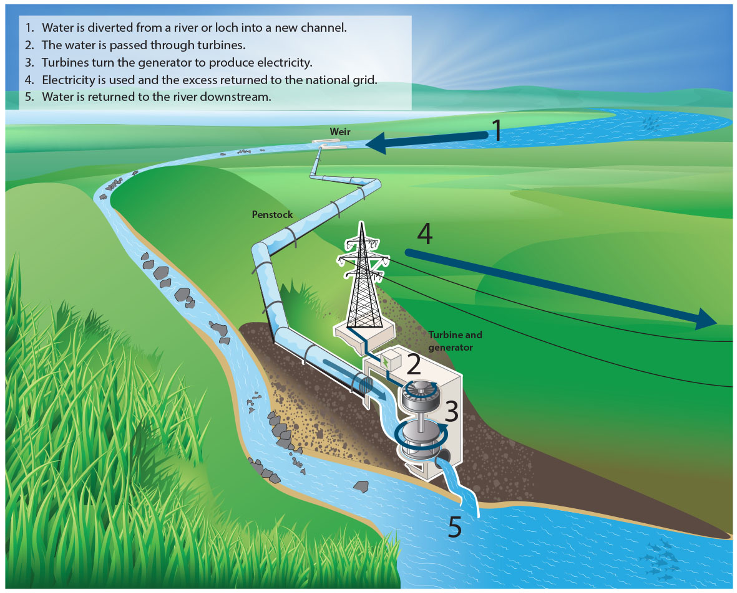
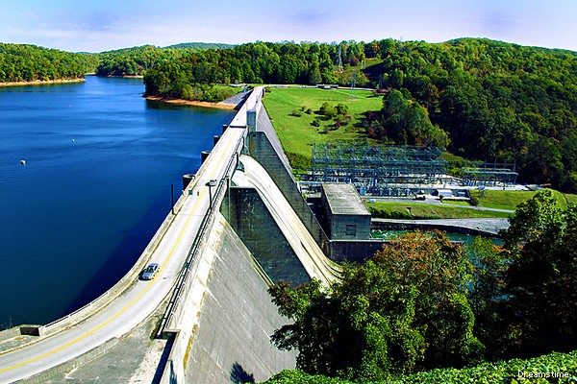
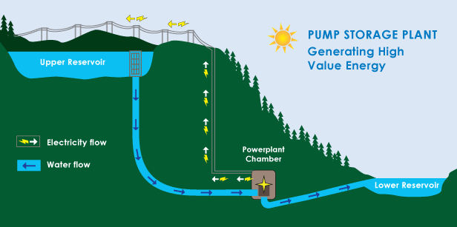
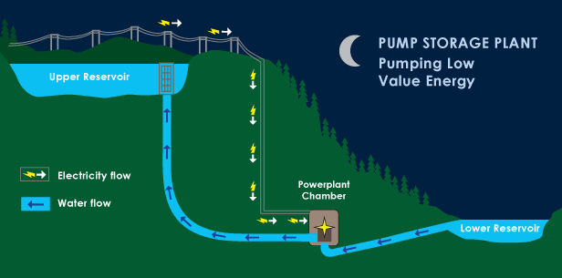
Technology overview
Classification of hydropower plants based on storage type
Run of River plants
Storage hydropower
Pumped hydro storage
Notes:
Specification type refers to classification based on structural issues and the category of load the power plant is intended to satisfy
Run-of-the-river plants : Plants that channels flowing water from a river through a canal or penstock to spin a turbine. Typically a run-of-river plant will have little or no storage facility. Run-of-river provides a continuous supply of electricity (base load), with some flexibility of operation for daily fluctuations in demand.
Storage hydropower: Plants facility that uses a dam to store water in a reservoir. Electricity is produced by releasing water from the reservoir through a turbine, which activates a generator. Storage hydropower provides base load as well as the ability to be shut down and started up at short notice according the demands of the system (peak load). It can offer enough storage capacity to operate independently of the hydrological inflow for many weeks or even months.
Pumped-storage hydropower: This facility provides peak-load supply, harnessing water which is cycled between a lower and upper reservoir by pumps which use surplus energy from the system at times of low demand. When electricity demand is high, water is released back to the lower reservoir through turbines to produce electricity.

Slide 5
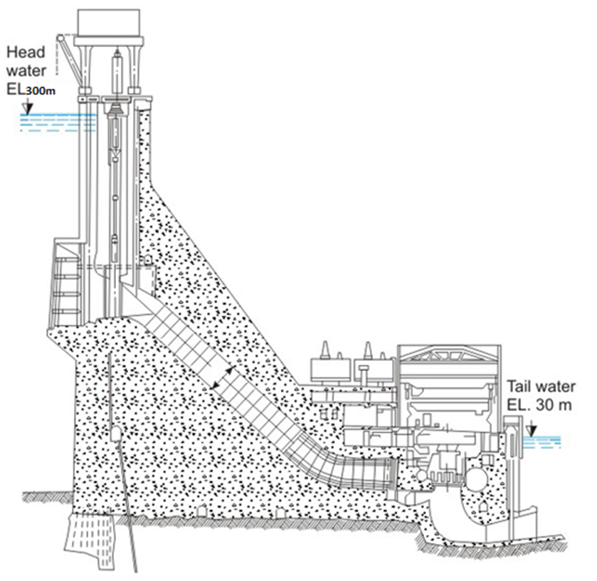
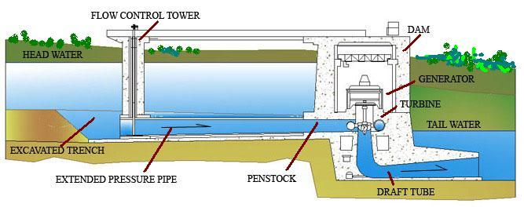
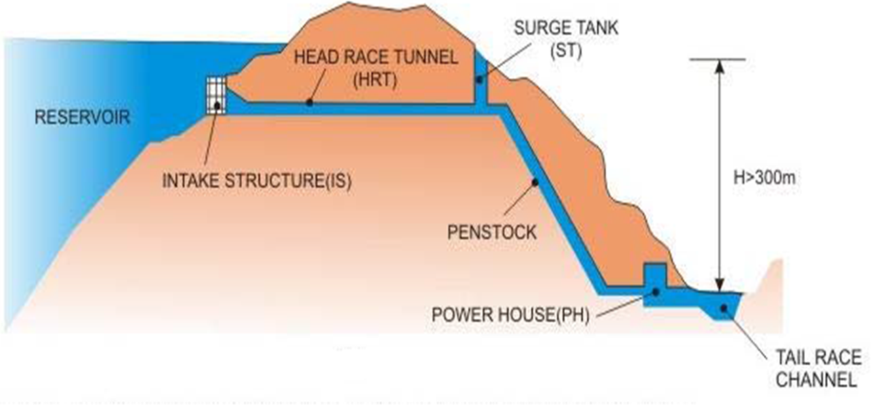
Technology overview
Classification of hydropower plants based on head
Low head
High Head
Medium Head
Notes:
On this slide we see three different types of hydro power plants, which are distinguished by their head. A low head implies that the reservoir could be almost completely emptied while a high head allows only a relatively small amount of the reservoir content to be used for power generation.
This has also implications on the operation of the power plant. A low head offers the option to store energy by holding back water. This stored energy can be used flexibly to balance the electricity system. However, the higher the head the less flexible the operation will be.

Slide 6
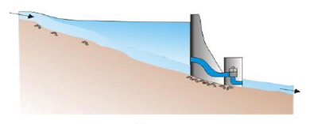
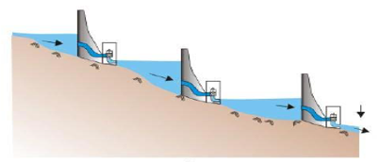
Reservoir operation
Classification of hydropower plants based on hydrological sequence
Single stage power plants
Cascade/Multistage hydropower plants
Notes:
Hydro power dams can work as single stage power plants or in a hydrological sequence.
When the run off from a single hydropower plant is diverted back into river or for any other purpose other than power generation, the setup is known as Single Stage
When two or more hydropower plants are used in series such that the runoff discharge of one hydro power plant is used as the is a intake discharge of the second hydro power plant such a system is known as Cascade hydropower plant.

Slide 7

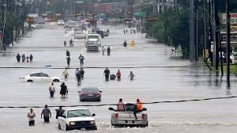
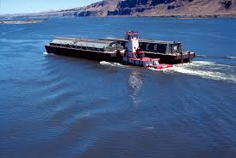
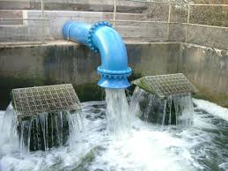
Technology overview
Classification of hydropower plants (Reservoirs) based on the purpose
Multi-purpose reservoirs
Water supply
Flood control
Soil erosion
Environmental management
Hydroelectric power generation
Navigation
Recreation
Irrigation
Notes:
Hydro power plants with reservoir can also fulfill more than the purpose of producing electricity. For example Water supply, Irrigation and or flood control.

Slide 8
Technical parameter
Notes:
Let’s now look a bit closer on how hydro power plants can be characterized.

Slide 9
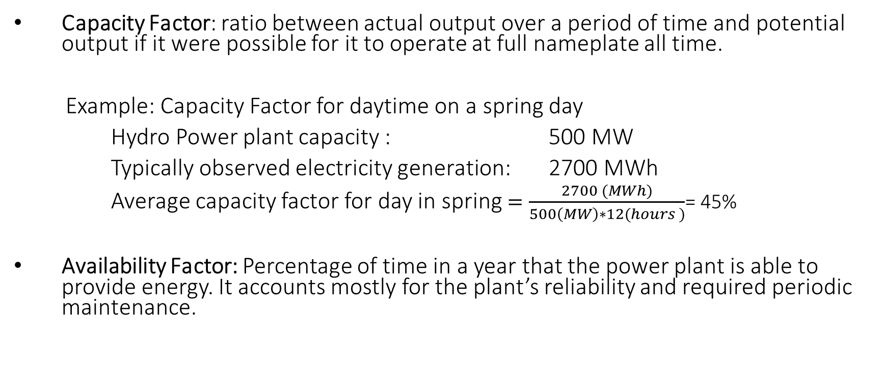
Hydro specific technical parameters
Capacity Factor: ratio between actual output over a period of time and potential output if it were possible for it to operate at full nameplate all time.
Example: Capacity Factor for daytime on a spring day
Hydro Power plant capacity : 500 MW
Typically observed electricity generation: 2700 MWh
Average capacity factor for day in spring $=\frac{2700 (MWh)}{500\left(MW\right)∗12(hours )}$= 45%
Availability Factor: Percentage of time in a year that the power plant is able to provide energy. It accounts mostly for the plant’s reliability and required periodic maintenance.
Notes:
Two important parameter to describe the availability of a technology in OSeMOSYS are the CapacityFactor and the AvailabilityFactor.
The fact that a plant exists does not mean that it can generate all of the time. For instance, a hydroelectric plant may be available, but there might not be sufficient water available to reach its rated output.
In OSeMOSYS the CapacityFactor indicates the availability of a technology in a specific TimeSlice, i.e. it indicates the share of the actual possible production of the total theoretically production.
This can depend for example on the resource availability e.g. water availability.
In comparison the Availability Factor indicates for how much time of the year the power plant is available to produce. The parameter is commonly used to indicate time that are needed for maintenance.

Slide 10
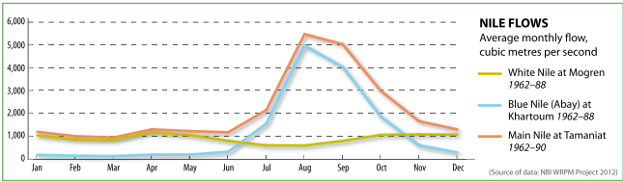
Hydro specific technical parameters
Flow rates
Notes:
How a hydro power plant operates depends heavily on its water supply. Many plants do not have enough water to operate anywhere near their full capacity on a continuous basis.
Lakes and man made reservoirs used for hydropower come in all sizes, holding enough water for as little as a one-day supply, or as much as a whole year's supply. A plant with a reservoir that holds less than the annual river flow may change its operating style depending on the season of the year. For example, the plant may operate as a peaking plant during the dry season, as a base load plant during the wet season and as a load following plant between seasons. A plant with a large reservoir may operate independently of wet and dry seasons, such as operating at maximum capacity during peak heating or cooling seasons.
The graph shown indicates the flow rates of the Nile River:
In Yellow: the White Nile,
In Blue: the Blue Nile,
And in Orange: the Main Nile
Run-Of-River power plants on the white nile are producing almost a constant output due to the constant water availability.
Whereas on the Blue Nile and therefore also on the Main Nile a strong seasonality can be observed. This would then also be reflected in the production pattern of Run-Of-River power plants on these rivers. However, reservoirs allow to shift the production by storing the water and using it at a later point for power production.

Slide 11
Techno-economic parameters
Source: IEA ETSAP 2010
Notes:
In the here shown table we have a summary of technical performance and costs parameter. It is distinguished between very small, small, and large hydro power plants. Hydro power plants have longer technical life times than most other power generation technologies. The capacity factor is of course strongly depending on the location of the power plant.
Investment cost are often also referred to as capital cost and consider the cost for infrastructure, technology and installation.
The OM cost are the fixed costs assigned to the operation and maintenance of the power plant.

